Slide 1
ADWENTUREWORKS SALES
PRESENTED TO THE SALES TEAM

Slide 2
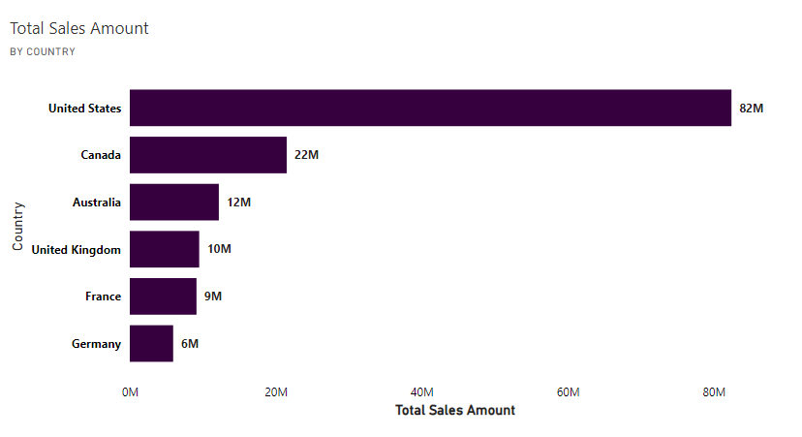
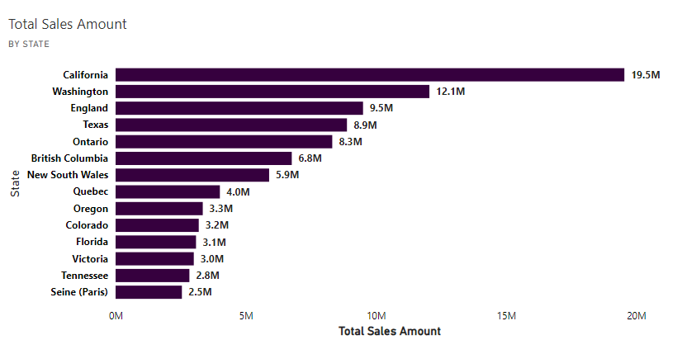
US accounts for majority of our Sales. California (19.5M) has sales almost worth the entirety of Canadian sales (22M)

Slide 3
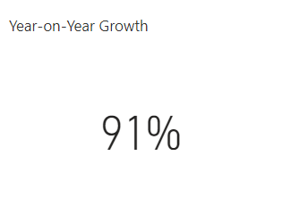
Year-on-year growth stands at 91%, indicating an impressive performance that should be maintained and built upon.

Slide 4
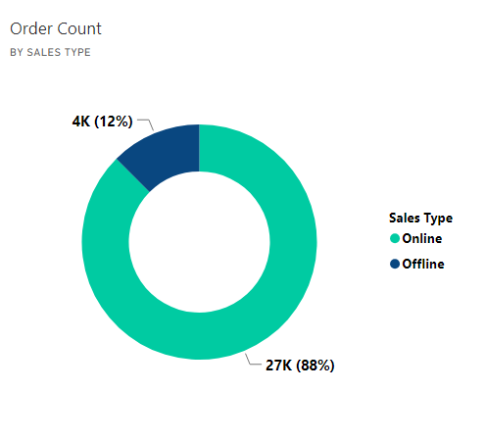
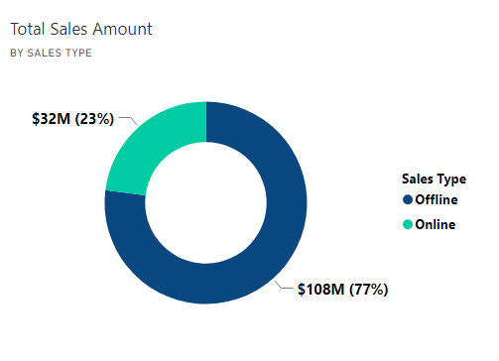
Although 88% of our orders came through Online channels, it generated just 23% of our revenue. 77% of our sales revenue was made through Offline channels.

Slide 5
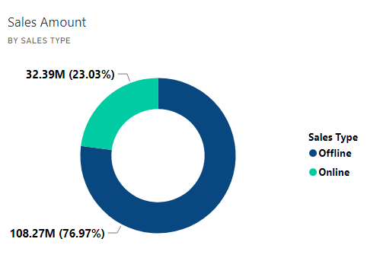
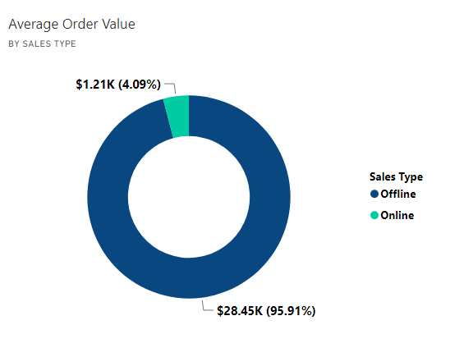
Again, the average order value of an online sale is about $1K, while for an offline sale $28K which is over 20 times more than Online sales.

Slide 6
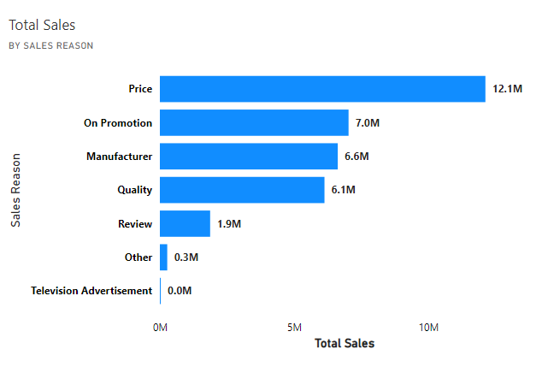
Pricing strategy (Pricing and Promotional) and quality of products (Manufacturer and Quality) are the major reasons for online Sales

Slide 7
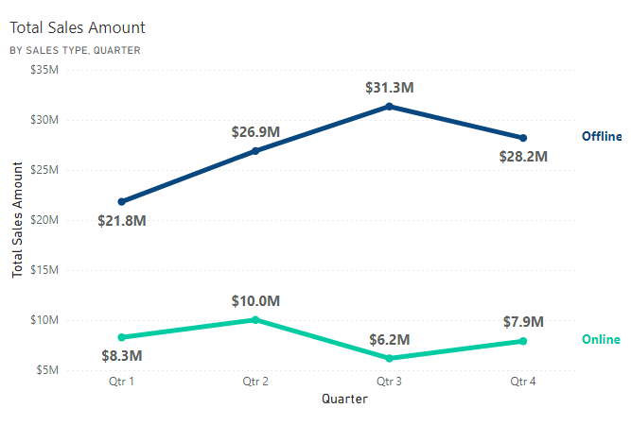
Q3 saw an increase in Offline sales accompanied by a decrease in Online sales.

Slide 8
Summary of Findings
Prices and Promotional offers being are biggest reasons for sales
Year-on-Year Growth stands tall at 91%.
Offline Sales are the major channel of sales.

Slide 9
Recommendations
Fair pricing should be maintained and more promotional offers should be provided.
Growth drivers such as Offline sales type, Prices and Quality of products should be maintained.

